Slide 1
Mining Spatiotemporal and Social Media Data
Jiawei Han
Computer Science
University of Illinois at Urbana-Champaign
July 20, 2015

Slide 2
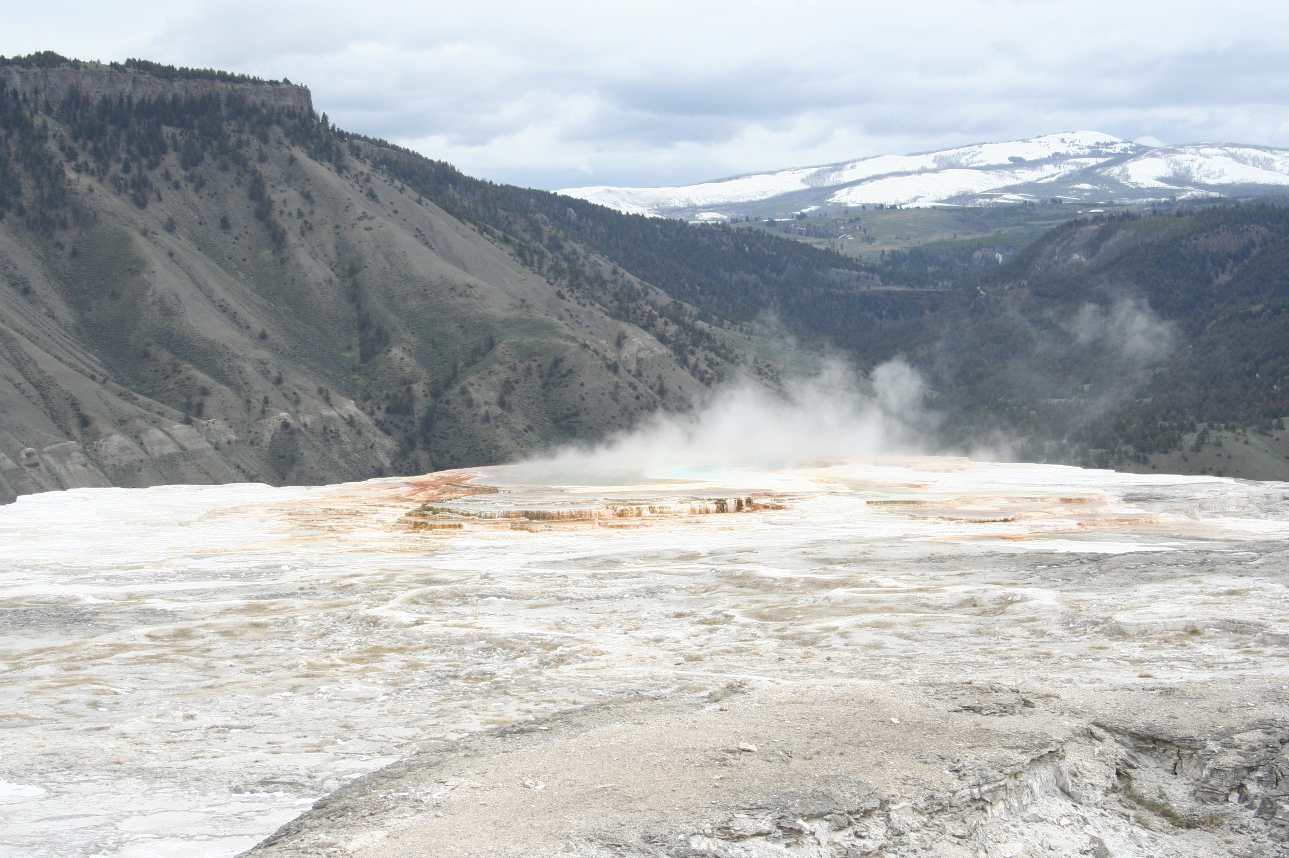

Slide 3
Outline
Introduction: Integrated Mining of Spatio, Temporal and Text Data
Mining Spatial Patterns
Mining and Aggregating Patterns over Multiple Trajectories
Mining Semantic-Rich Movement Patterns
Mining Periodic Movement Patterns
GeoTopic Discovery
From Mining Social Relationships
Summary

Slide 4
Introduction: Integrated Mining of Spatial, Temporal and Text Data
Link
Text-Rich Information Network Analysis
Text
Latent Geographical Topic Analysis
Latent Periodic Topic Analysis
Spatial Data
Temporal Data
Trajectory Mining
Time-Series Analysis
Periodicity Mining
Spatial Data Mining

Slide 5
Outline
Introduction: Integrated Mining of Spatial, Temporal and Text Data
Mining Geospatial Patterns
Mining and Aggregating Patterns over Multiple Trajectories
Mining Semantic-Rich Movement Patterns
Mining Periodic Movement Patterns
GeoTopic Discovery
From Mining Social Relationships
Summary

Slide 6
Spatial Patterns and Associations
Spatial frequent patterns and association rule: A ⇒ B [s%, c%]
A and B are sets of spatial or non-spatial predicates, e.g.,
Topological relations: intersects, overlaps, disjoint, etc.
Spatial orientations: left_of, west_of, under, etc.
Distance information: close_to, within_distance, etc.
Measures: s%: support, and c%: confidence of the rule
Example: Rules likely to be found
is_a(x, large_town) ^ intersect(x, highway) → adjacent_to(x, water) [7%, 85%]
Explore spatial autocorrelation: Spatial data tends to be highly self-correlated (nearby things are more related than distant ones)
E.g., neighborhood, temperature

Slide 7
Mining Spatial Associations: Progressive Refinement
Hierarchy of spatial relationship:
close_to is a generation of near_by, touch, intersect, contain, ...
Progressive refinement: First search for rough relationship and then refine it
Two-step mining of spatial association:
Step 1: Rough spatial computation (as a filter)
Using MBR (Minimum Bounding Rectangle) or R-tree for rough estimation
Step2: Detailed spatial algorithm (as refinement)
Apply only to those objects which have passed the rough spatial association test (no less than min_support)

Slide 8
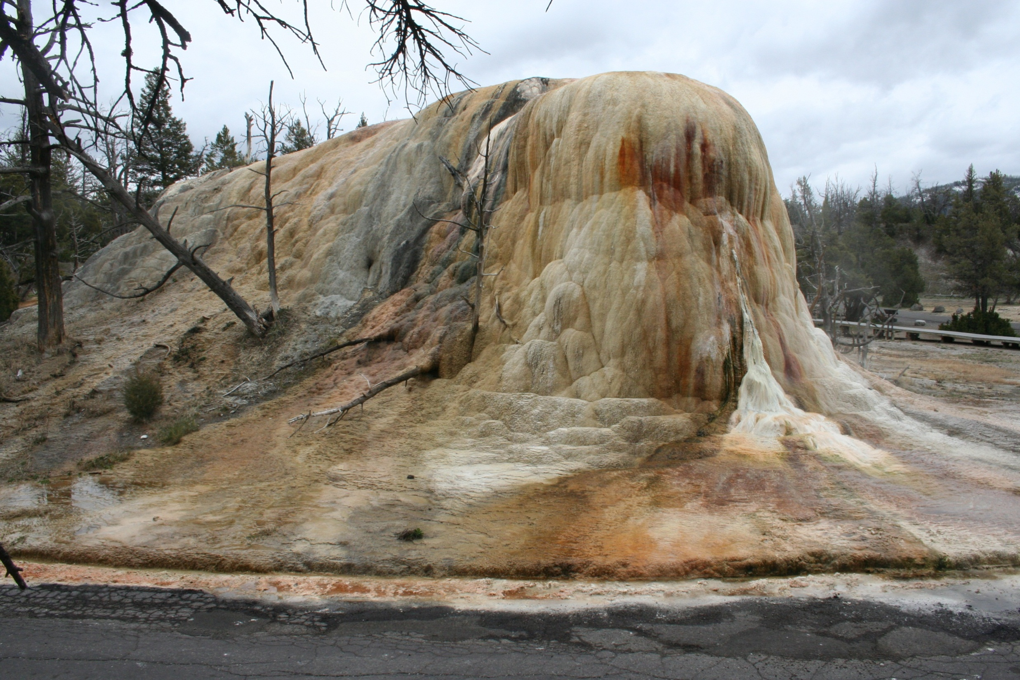

Slide 9
Outline
Introduction: Integrated Mining of Spatial, Temporal and Text Data
Mining Geospatial Patterns
Mining and Aggregating Patterns over Multiple Trajectories
Mining Semantic-Rich Movement Patterns
Mining Periodic Movement Patterns
GeoTopic Discovery
From Mining Social Relationships
Summary

Slide 10
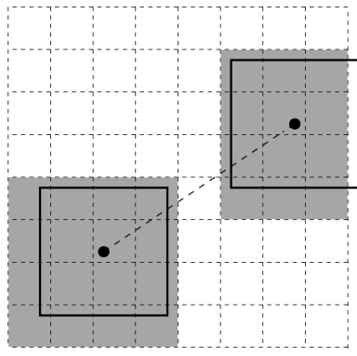
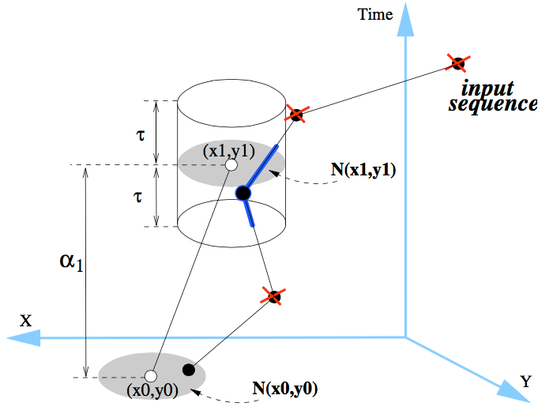
Partition-Based Trajectory Pattern Mining
Partition-Based Trajectory Pattern Mining (e.g., Mining T-Patterns) [1]:
First partition the space into equal-width grids and obtain Regions-of-Interests (RoIs)
Then transform each input trajectory into a time-annotated symbolic sequence
Use constraint-based sequential pattern mining to find trajectory patterns
[1] F. Giannotti, M. Nanni, F. Pinelli, D. Pedreschi, Trajectory Pattern Mining, KDD’07

Slide 11
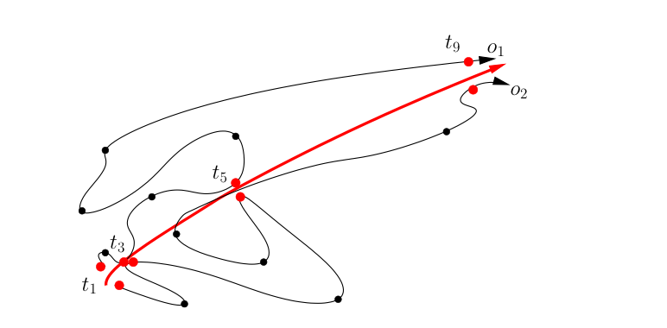
Detecting Moving Object Clusters
Flock and convoy: Both require k consecutive time stamps
Flock: At least m entities are within a circular region of radius r and move in the same direction
Convoy: Density-based clustering at each timestamp; no need to be a rigid circle
Swarm: Moving objects may not be close to each other for all the consecutive time stamps
Efficient pattern mining algorithms for uncovering such swarm patterns

Slide 12
Trajectory Clustering: A Partition-and-Group Framework
Grouping trajectories as a whole ⇒ cannot find similar portions of trajectories
Solution: discovers common sub-trajectories, e.g., forecast hurricane landfall
Two phases: partitioning and grouping
TR₄
TR₅
Identify the points where the behavior of a trajectory changes rapidly ⇒ characteristic points
Based on the minimum description length (MDL) principle
TR₃
(1) Partition
A set of trajectories
TR₂
TR₁
A representative trajectory
(2) Group
A cluster
A set of line segments
J.-G. Lee, et al., "Trajectory Clustering: A Partition-and-Group Framework", SIGMOD'07
: characteristic point : trajectory partition

Slide 13


Slide 14
Outline
Introduction: Integrated Mining of Spatial, Temporal and Text Data
Mining Geospatial Patterns
Mining and Aggregating Patterns over Multiple Trajectories
Mining Semantic-Rich Movement Patterns
Mining Periodic Movement Patterns
GeoTopic Discovery
From Mining Social Relationships
Summary

Slide 15
Mining Frequent Movement Patterns
Frequent Movement Pattern: A movement sequence that frequently appears in the input trajectory database
Frequent Movement Pattern vs. Frequent Sequential Pattern
Both aim at finding frequent subsequences from the input sequence database
For mining frequent movement patterns, similar places may need to be grouped to collectively form frequent subsequences
An example trajectory
An example movement pattern

Slide 16
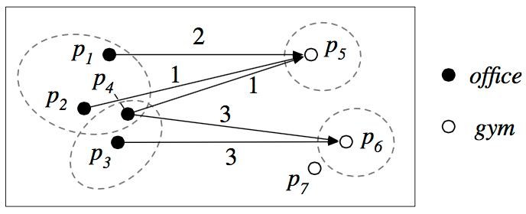
Mining Semantic-Rich Movement Patterns
Semantics-rich Movement Pattern: In addition to knowing how people move from one region to another, we also want to understand the functions of the regions
A two-step top-down mining approach:
Step 1: Find a set of coarse patterns that reflect people’s semantics-level transitions (e.g., office → restaurant, home → gym)
Step 2: Split each coarse pattern into several fine-grained ones by grouping similar movement snippets
[1] C. Zhang et al., Splitter: Mining Fine-Grained Sequential Patterns in Semantic Trajectories, VLDB 2014

Slide 17
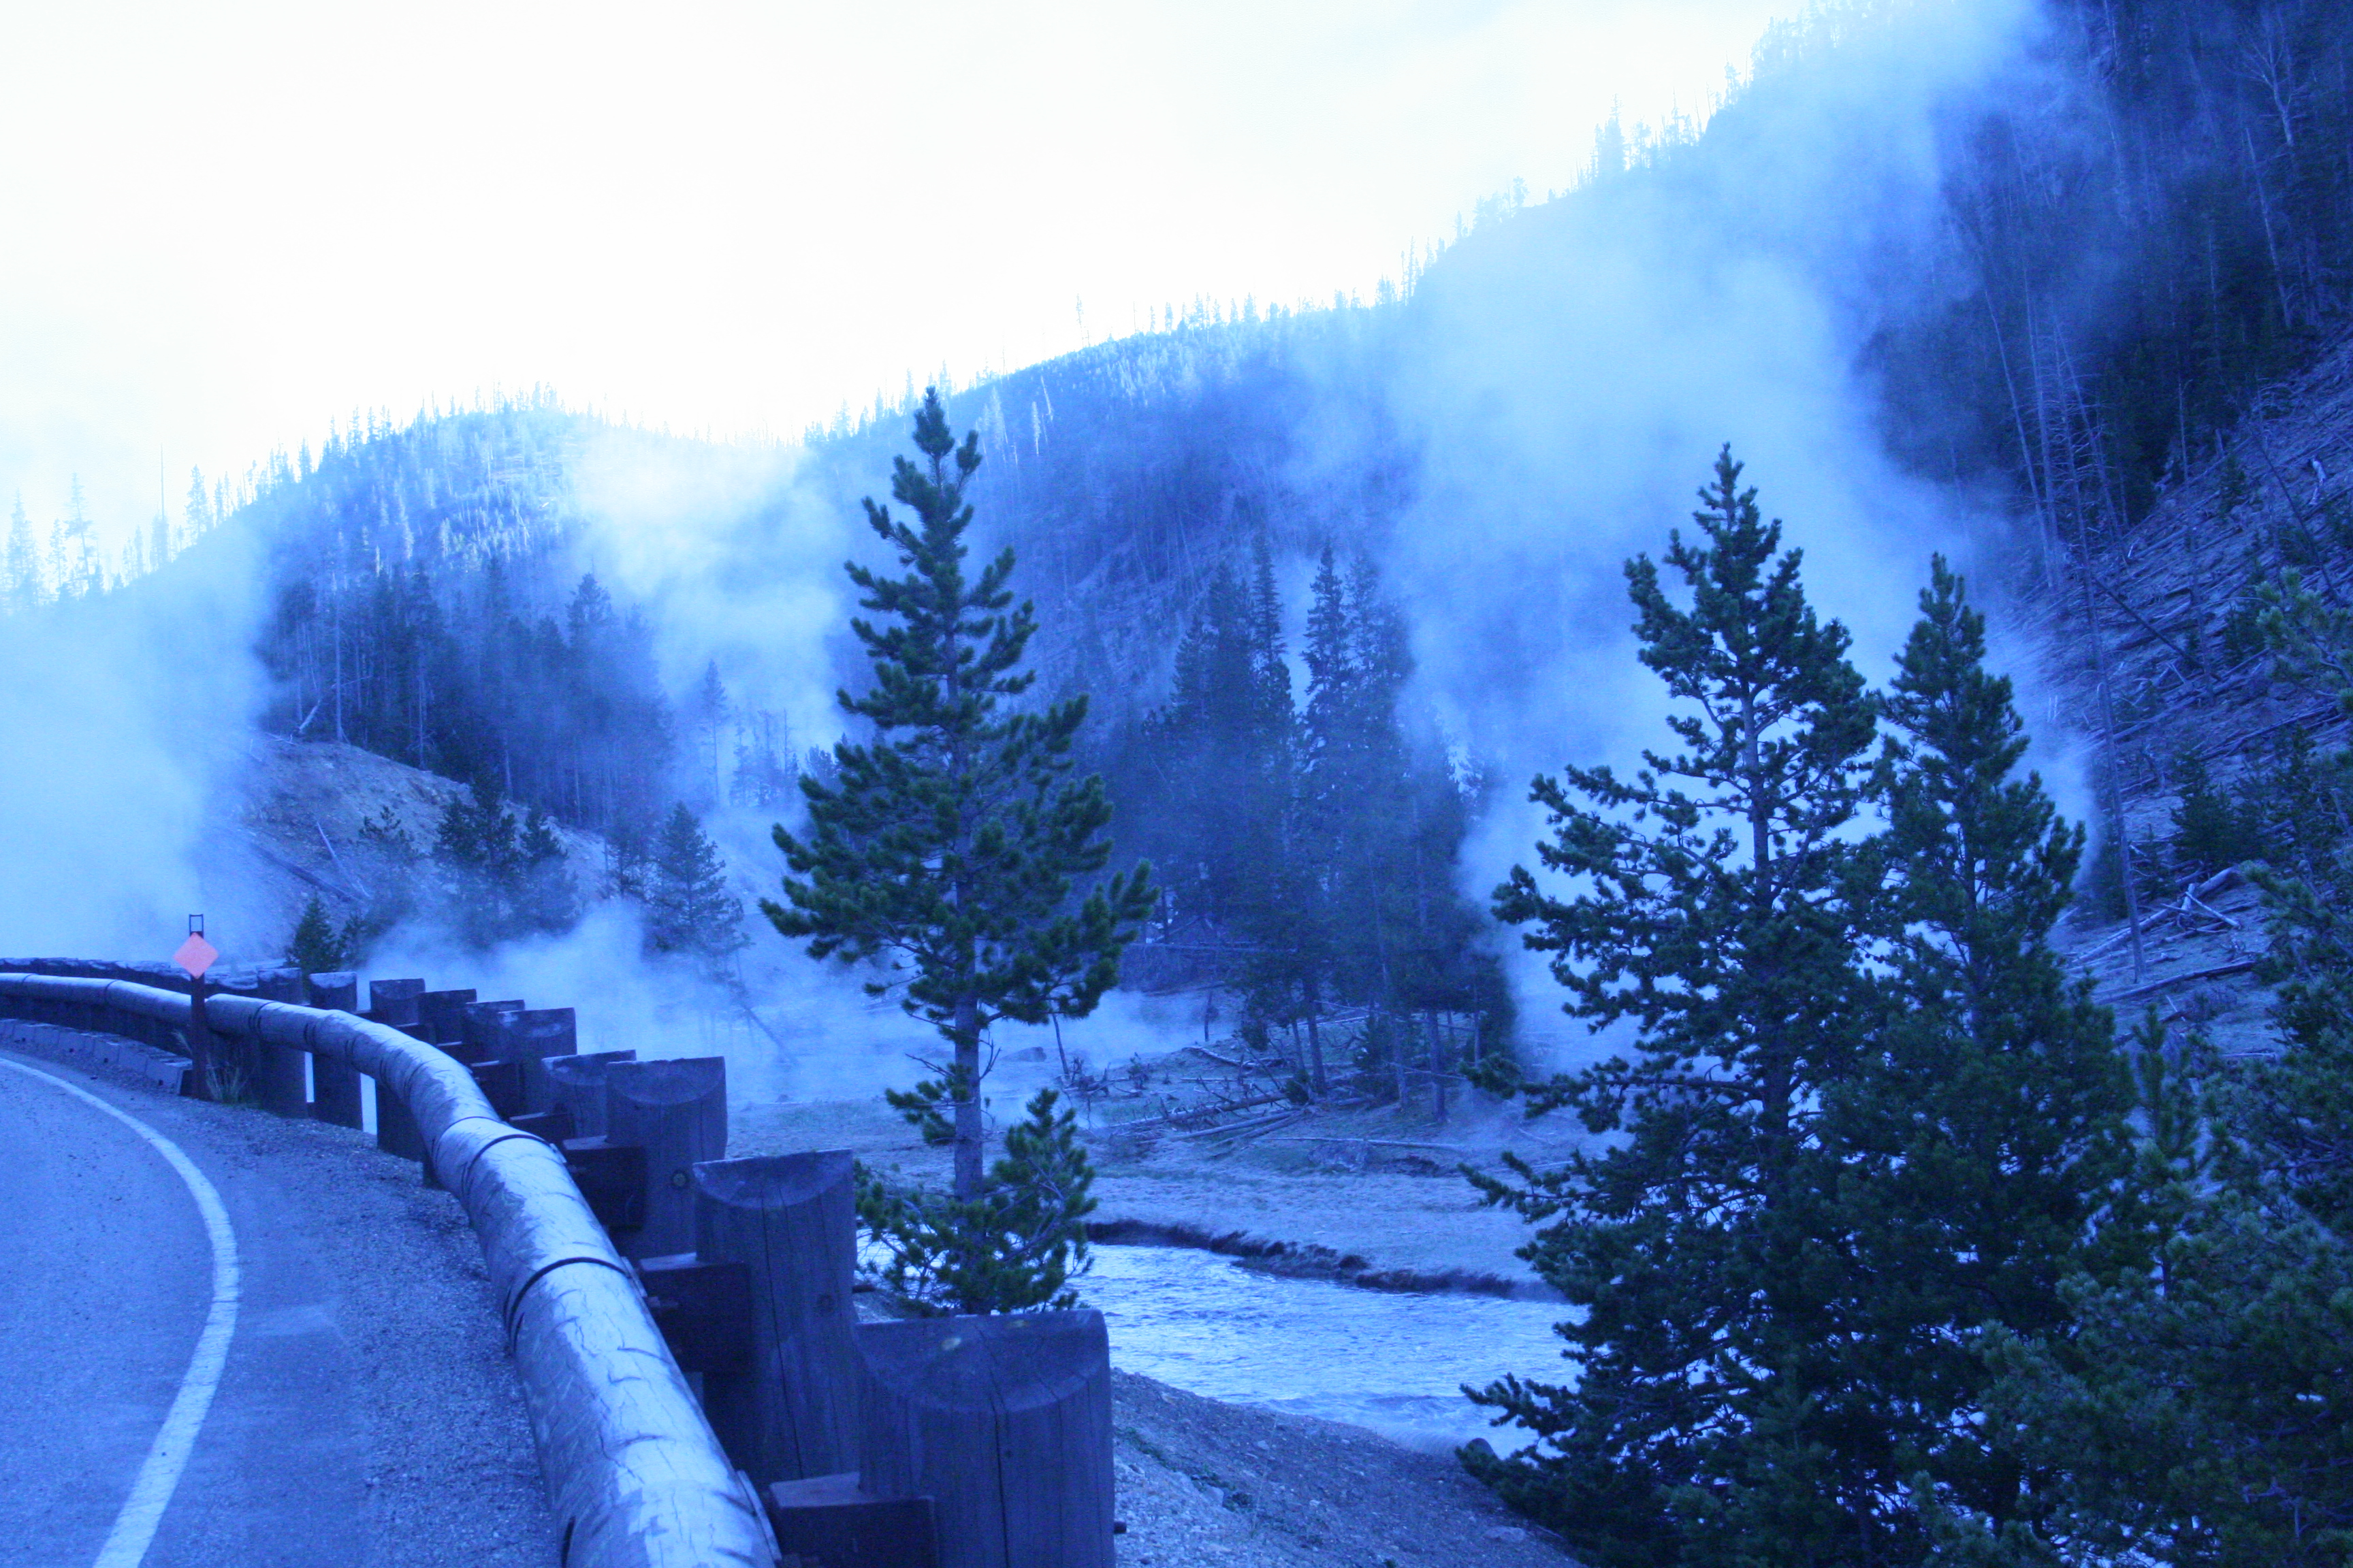

Slide 18
Outline
Introduction: Integrated Mining of Spatial, Temporal and Text Data
Mining Geospatial Patterns
Mining and Aggregating Patterns over Multiple Trajectories
Mining Semantic-Rich Movement Patterns
Mining Periodic Movement Patterns
GeoTopic Discovery in Social Media
From Mining Social Relationships
Summary

Slide 19
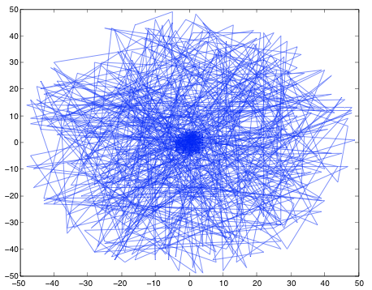
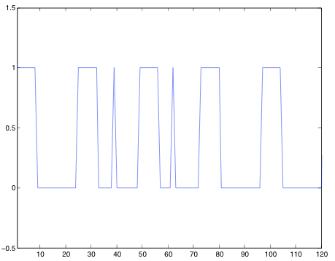
Pattern Discovery in Sparse Movement Data: Finding Good Reference Points
Pattern discovery in sparse data:
Periodicity shows up in some reference “spots” (or “cluster centers”)
Reference spots can be detected using density-based method
Periods are detected for each reference spot using Fourier Transform and auto-correlation
in the nest
not in the nest
Finding being flying patterns? Bee hive is a good reference point
Period is more obvious in this binary sequence!

Slide 20
Pattern Discovery in Sparse Movement Data: Finding Good Reference Points
Pattern discovery in sparse data:
Periodicity shows up in some reference “spots” (or “cluster centers”)
Reference spots can be detected using density-based method
Periods are detected for each reference spot using Fourier Transform and auto-correlation
in the nest
not in the nest
Finding being flying patterns? Bee hive is a good reference point
Period is more obvious in this binary sequence!

Slide 21
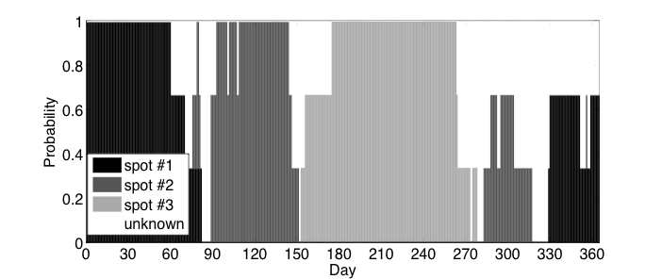
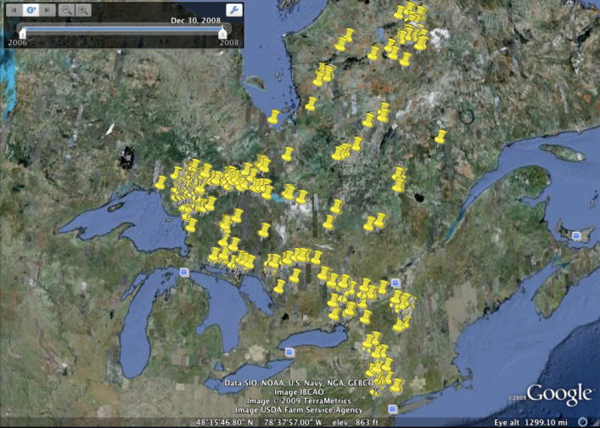
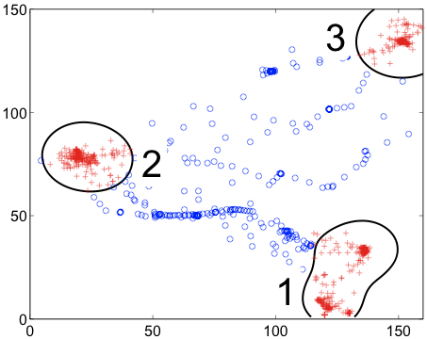
Example: Mining Periodic Patterns with Sparse Data
3-yr Bird migration data: very sparse
Jan.-Mar.
Apr.-June
July-.Oct
Nov.
Dec.
Detecting periods: Cluster data to find reference “points” and then detect multiple interleaved periods by Fourier Transform and auto-correlation
Summarizing periodic patterns: By clustering and pattern discovery

Slide 22
Periodicity Detection in Sparse Data
Real movement data can be sparse, e.g., geo-location at phone calls
Projecting on the true period, it shows a highly skewed (clustered) distribution
Effective method can be developed based on this observation (Li, et al., 2015)

Slide 23
Outline
Integrated Mining of Spatial, Temporal and Social Media Data
Mining Geospatial Patterns
Mining and Aggregating Patterns over Multiple Trajectories
Mining Semantic-Rich Movement Patterns
Mining Periodic Movement Patterns
GeoTopic Discovery in Social Media
From Mining Social Relationships
Summary

Slide 24

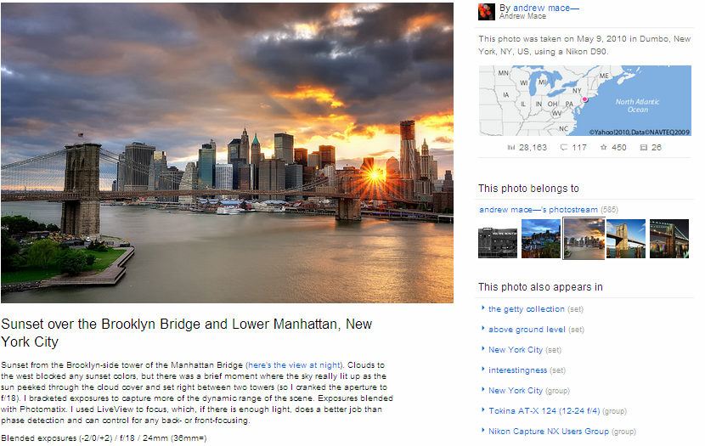


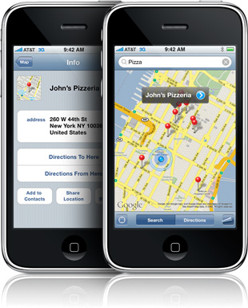
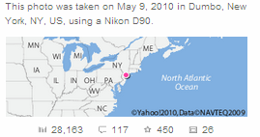
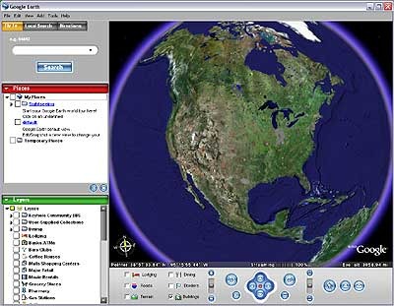
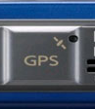
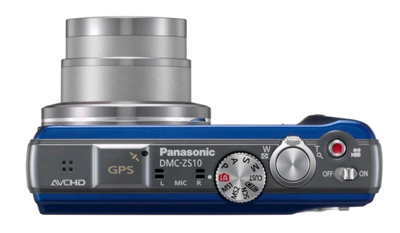
Social Media Are Popular in Today’s World
Social media contains very rich spatial, temporal, text, photo, link, social network information
Examples
Twitter: tweets from smart phones
Geo-tagged tweets
Flickr: geo-tagged photos
Advanced cameras with GPS receivers
Applications including Google Earth, Flickr, etc.
GPS functions in smart phones
Social media data mining: A rich frontier

Slide 25
LGTA: Mining Spatial Text Documents
Applications
Analyze the cultural differences around the world
Explore the hot topics or events in different places
Compare the popularity of specific products in different regions
Discover different topics of interests those are coherent in geographical regions
Compare several topics across different geographical locations
Zhijun Yin, Liangliang Cao, Jiawei Han, Chengxiang Zhai, and Thomas Huang, “Geographical Topic Discovery and Comparison”, Proc. of 2011 Int. World Wide Web Conf. (WWW'11), Hyderabad, India, Mar. 2011.

Slide 26
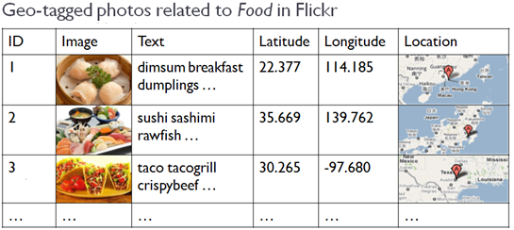
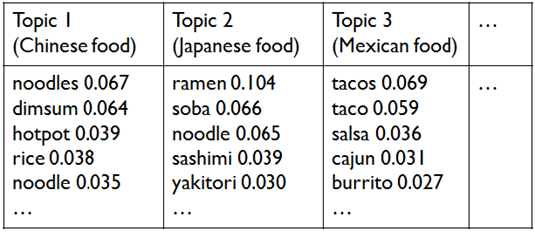
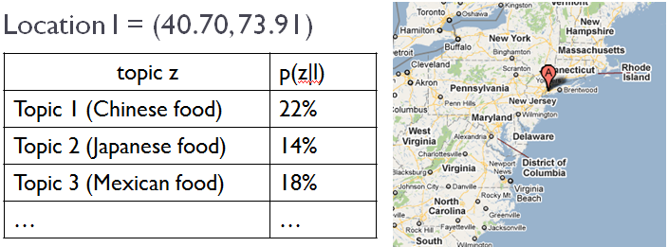
GeoTopic: From Geo-Tagged Text to Topic Clusters
Output:
Geographic topics: { p(w|z) }
p(w|z₁), p(w|z₂), p(w|z₃)
Topic distribution p(z|l)
Input: Text with spatial information

Slide 27
Potential Solutions: Previous Work
LDM: Location-driven model
Clustering based on document locations
One location cluster is a topic
TDM: Text-driven model [Mei et al. WWW’08]
Topic modeling with network regularization
Documents that are close in space should have similar topic distributions
GeoFolk [Sizov WSDM’10]
A topic modeling that uses both text and spatial information
The geographical distribution of each topic is Gaussian

Slide 28
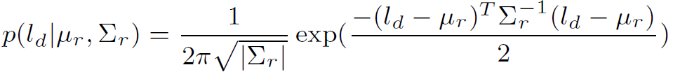
LGTA: General Ideas (Location-Text Join Model)
Geographical topic discovery
Topics are generated from regions instead of documents:
The geographic distribution of each region follows a Gaussian distribution
The words that are close in space likely belong to the same region and thus should be clustered into the same geographical topic
To generate a geographical document d in a collection D:
Sample a region r from the discrete distribution of region importance α:
r ~ Discrete (α)
Sample location l_{d} from Gaussian distribution of µ_{r} and ∑_{r}
To generate each word in document d:
(a) sample a topic z from multinominal φ_{r}
(b) sample a word w from multinominal θ_{z}
Each topic can be related to several regions
Parameters can be estimated using an EM algorithm

Slide 29
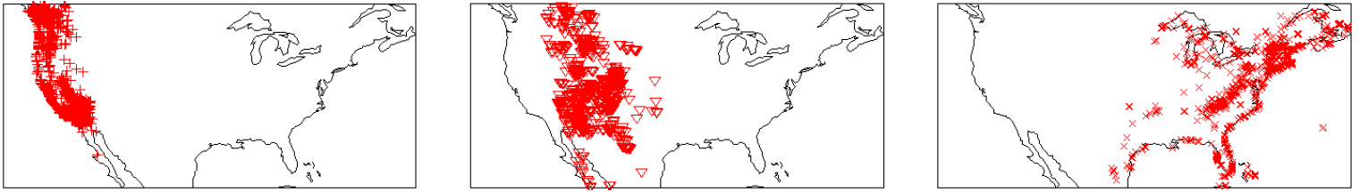
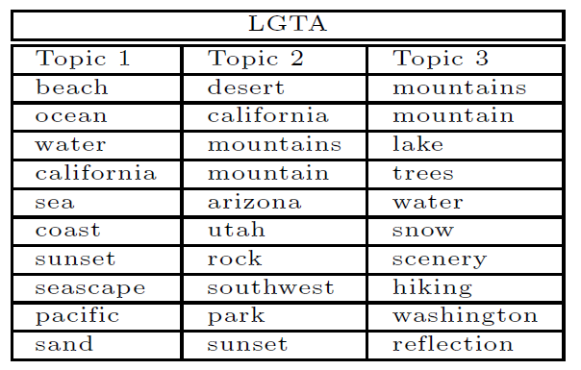
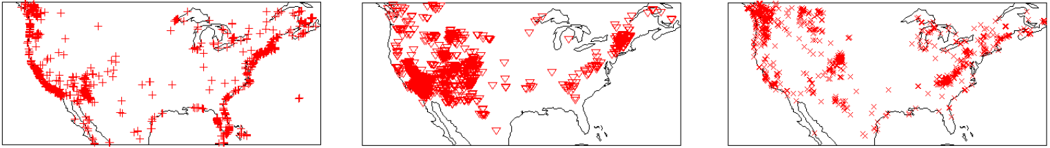
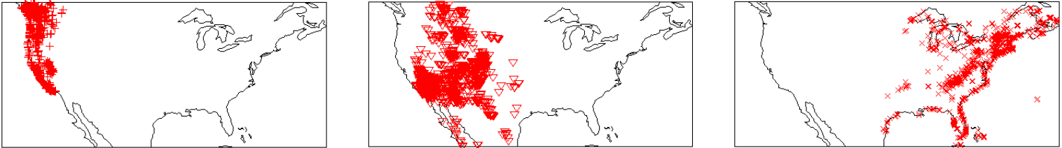
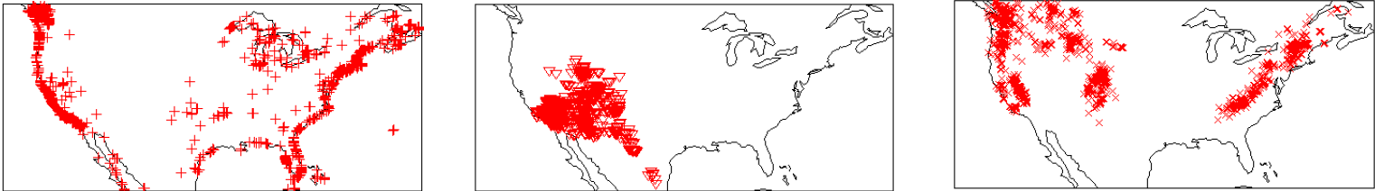
Performance Comparison: Geo-Tagged Photos Related to Landscape (coast vs. desert vs. mountain)
LDM
TDM
GeoFolk
LGTA

Slide 30
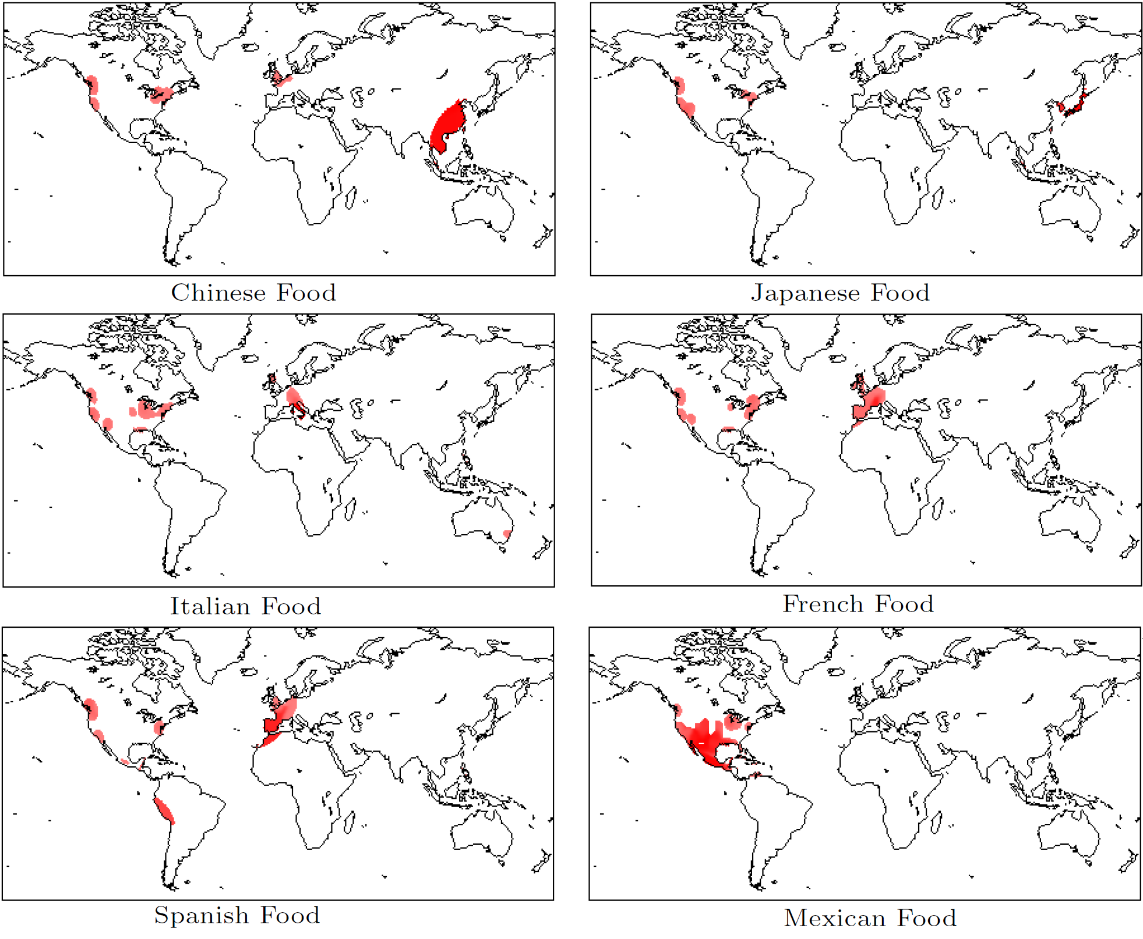
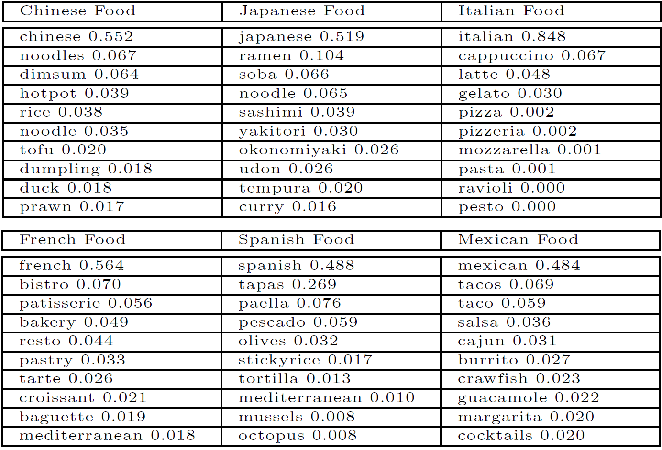
LGTA: Geographical Food Topic Comparison
Prior
The larger p(topic|location) is, the darker the location is

Slide 31
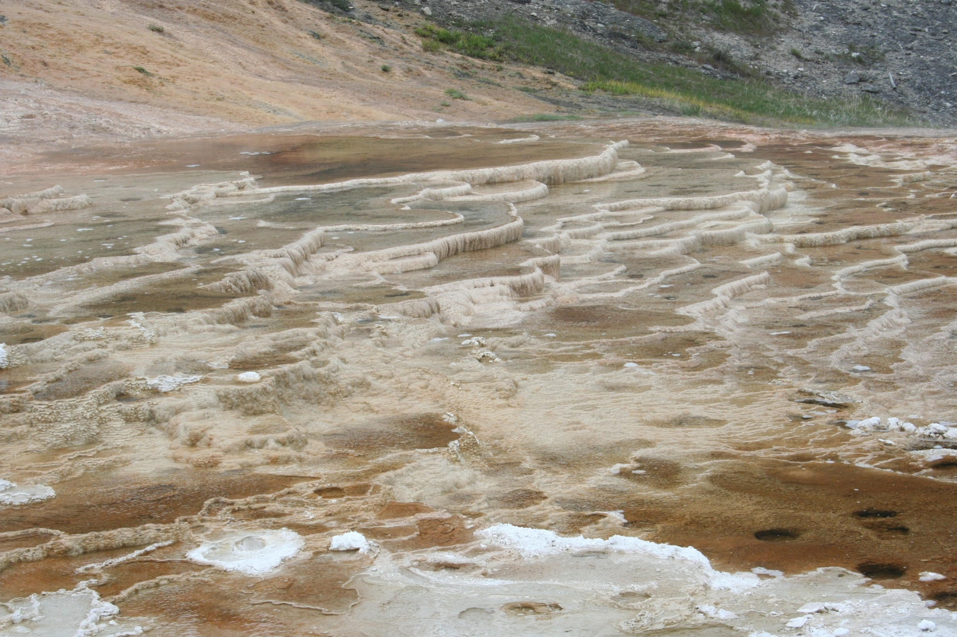

Slide 32
Outline
Introduction
Mining Geospatial Patterns
Mining and Aggregating Patterns over Multiple Trajectories
Mining Semantic-Rich Movement Patterns
Mining Periodic Movement Patterns
GeoTopic Discovery in Social Media Data
Latent Periodic Topic Discovery
Real-Time Local Event Detection from Geo-Tagged Social Media
Summary

Slide 33
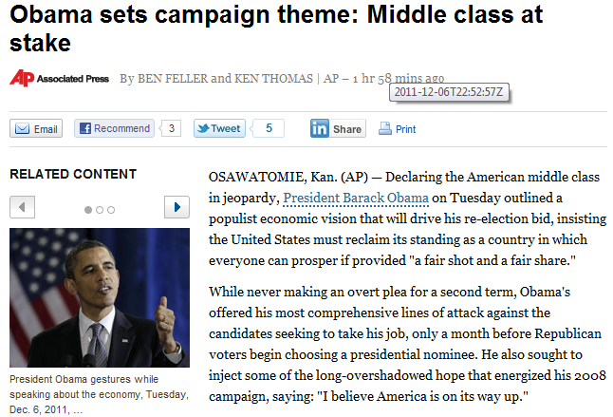
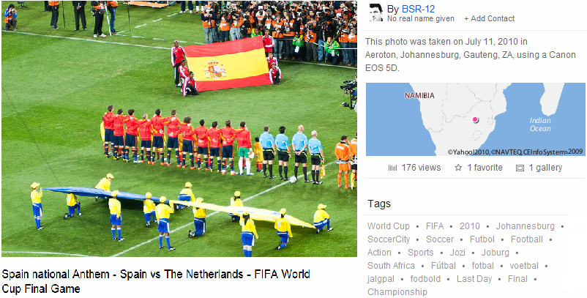
Latent Periodic Topic Analysis [ICDM’11]
Z. Yin, L. Cao, J. Han, C. Zhai, and T. Huang, "LPTA: A Probabilistic Model for Latent Periodic Topic Analysis", ICDM'11
Periodic phenomena exist ubiquitously
Hurricanes
Music and film festivals
Product sales
TV program
Publicly traded company
Most text articles have time associated with
Ex. 1. News articles associated with pub. dates
Ex. 2. Tagged photos annotated with dates in Flickr
Notes:
Many periodic phenomena exist in our lives, and lots of natural and social topics have periodic recurring patterns. Hurricanes strike over the similar seasons every year. Many music and film festivals are held during similar periods annually. Sales offered by different brands culminate during Thanksgiving and Christmas every year. TV programs usually follow weekly schedules. Publicly traded companies are required to disclose information on an ongoing basis by submitting both annual reports and quarterly reports. From these examples, we can see that periodicity analysis is important in real world.

Slide 34
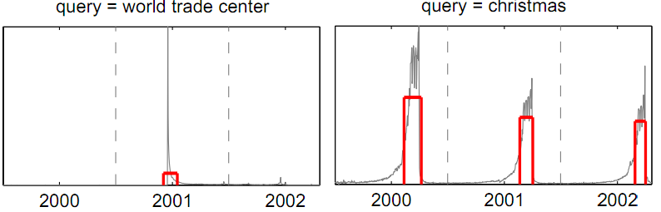
Apply Periodicity Analysis on Text Data
Periodicity detection for time series database [Elfeky et al. TKDE 2005]
Some studies follow the similar strategies to analyze the time distribution of a single tag or query to detect periodic patterns [Vlachos et al. SIGMOD 2004]
Challenges
A single word is not enough to describe a topic and more words are needed to summarize a topic comprehensively
Analyzing the periodicity of single terms is insufficient to discover periodic topics
E.g., “music”, “festival” and “chicago” may not have periodic patterns if considered separately, but there may be periodic topics if considered together
Synonyms and polysemy words due to the language diversity
Notes:
A lot of useful information is embedded in these text data, and it is interesting to discover topics that are periodic and characterize their temporal patterns. Many research works have been proposed in periodicity detection for time series database. Some studies follow the similar strategies to analyze the time distribution of a single tag or query to detect periodic patterns. However, most of the existing studies are limited to time series database and cannot be applied on text data directly.

Slide 35
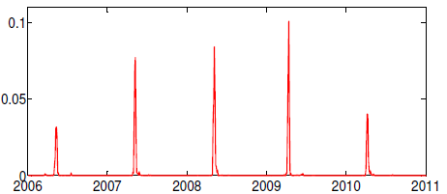
Latent Periodic Topic Analysis (LPTA)
Input:
Time-stamped documents
ID | Text | Date
1 | coachella, music, arts, festival, … | Apr 27 2008
2 | sxsw, south by southwest, austin, … | Mar 14 2008
… | … | …
Output:
1. Periodic topics: { p(w|z) } 2. Time distribution of topics
Periodic interval T, e.g., 1 year, etc.
Topic 1 (Coachella Festival) | …
coachella 0.1106 | …
music 0.0915 | …
indio 0.0719 | …
california 0.0594 | …
concert 0.0357 | …
… | …
The distribution of the timestamps for the topic related to Coachella festival

Slide 36
Latent Periodic Topic Analysis: Problem Formulation
Input:
A collection of time-stamped documents D
The number of topics K
Periodic interval T
Output:
K periodic topics
p(w|z) is the probability of word w given topic z
The distribution of the timestamps for each topic

Slide 37
General Idea of LPTA
Related work
Periodicity Analysis in time-series DB [Elfeky et al., 2005]
Topic models: PLSA [Hofmann SIGIR 1999] and LDA [Blei et al. JMLR 2003]
Topic Over Time [Wang et al. KDD 2006], etc.
LPTA (Latent Periodic Topic Analysis): General Ideas
Term co-occurrence
If two words co-occur often in the same documents, they are more likely to belong to the same topic
Temporal structure
We assume that there are many consecutive periods across the time line
The words occurring around the same time in each period are likely to be clustered

Slide 38
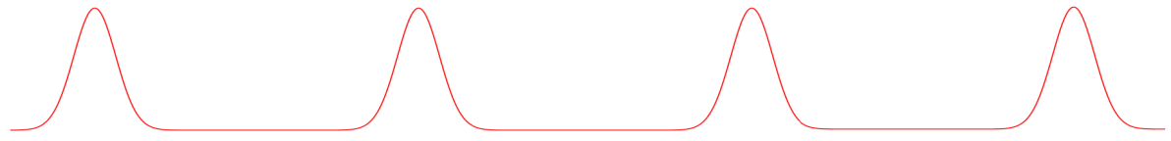

Temporal Patterns of Topics
Periodic topics
A periodic topic is one repeating in regular intervals
The distribution of timestamps for each periodic topic as a mixture of Gaussian distributions where the interval between the consecutive components is T
Background topics
A background topic is one covered uniformly over the entire period
The timestamps of the background topics are generated by a uniform distribution
Bursty topics
A bursty topic is a transient topic that is intensively covered only in a certain time period
The timestamps of the bursty topics are generated from a Gaussian distribution
The document collection is modeled as a mixture of background topics, bursty topics and periodic topics

Slide 39
Generative Process of LPTA
For each word in document d from collection D:
Sample a topic z from multinomial
(a) If z is a background topic, sample time t from a uniform distribution [t_{start} , t_{end}], where t_{start} and t_{end} are the start time and end time of the document collection
(b) If z is a bursty topic, sample time t from
(c) If z is a periodic topic, sample period k of document d from a uniform distribution. Sample time t from where T is periodic interval
Sample a word w from multinomial

Slide 40
Log-likelihood of Document Collection
Given the data collection where w_{d} is the word set in document d and t_{d} is the timestamp of document d, the log-likelihood of the collection given
is as follows
If topic z is a background topic,
If topic z is a bursty topic,
If topic z is a periodic topic,

Slide 41
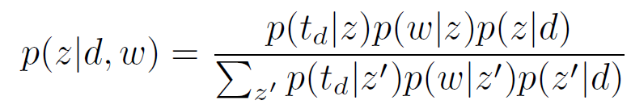
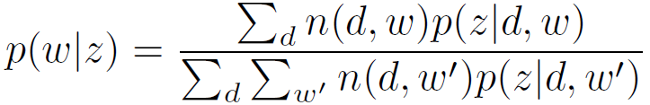
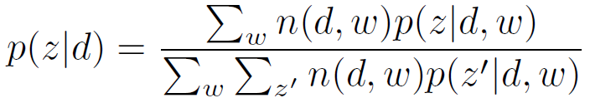
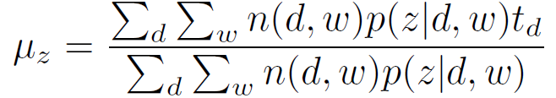
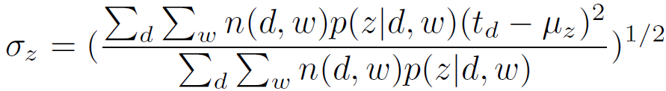
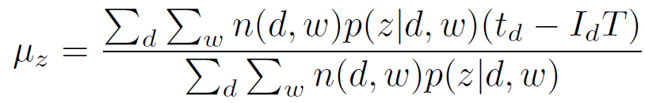
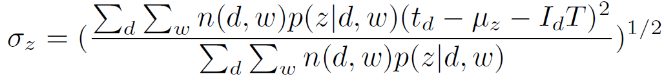
Parameter Estimation
EM (Expectation Maximization) algorithm
E-step
M-step
For bursty topic z
For periodic topic z
Complexity: O(iter K|W|) where iter is the number of the iterations in EM, K is the number of topics, |W| is the total count of the words in all the documents

Slide 42
Experimental Datasets
Seminar
Weekly seminar announcements for one semester from six research groups @CS, UIUC
61 documents and 901 unique words
Set periodic interval T as 1 week
DBLP (Computer Science Digital Bibliography)
The paper titles of several confs (WWW, SIGMOD, SIGIR, KDD, VLDB and NIPS) from 2003 to 2007
The timestamps of the documents are determined w.r.t. the conference programs
4070 documents and 2132 unique words
Set periodic interval T as 1 year
Flickr
The photos for several music festivals from 2006 to 2010 including SXSW (South by Southwest), Coachella, Bonnaroo, Lollapalooza and ACL (Austin City Limits)
The tags of a photo are considered as document text, while the time when the photo was taken is considered as document timestamp
84244 documents and 7524 unique words. Set periodic interval T as 1 year

Slide 43
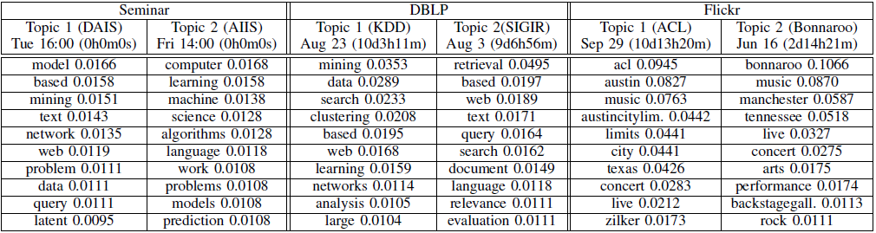
Topics Discovered by LPTA
Selected periodic topics discovered by LPTA
The date and the duration in the parentheses are the mean and standard deviation of the timestamps for the corresponding periodic topic

Slide 44
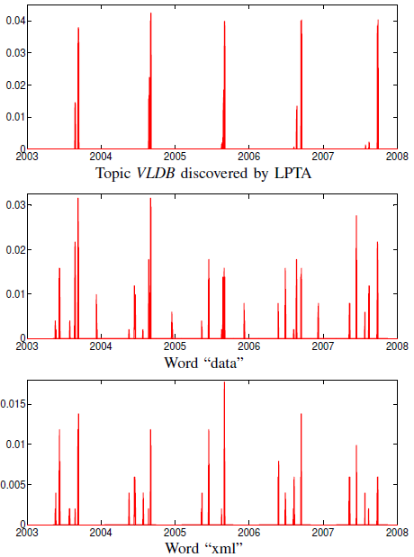
LPTA vs. Periodicity Detection
AUTOPERIOD [Vlachos et al. SDM 2005], a two-tier approach by considering the information in both the autocorrelation and the periodogram, fails to detect meaningful periodic words because the time series are sparse and few words have apparent periodic patterns.
Compared with single word representation, LPTA uses multiple words to describe a topic
In DBLP, topic “VLDB”: data 0.0530, xml 0.0208, query 0.0196, queries 0.0176, efficient 0.0151, mining 0.0142, database 0.0136, streams 0.0112, databases 0.0111
Time distribution of topic VLDB discovered by LPTA and time distributions of the words in the topic

Slide 45
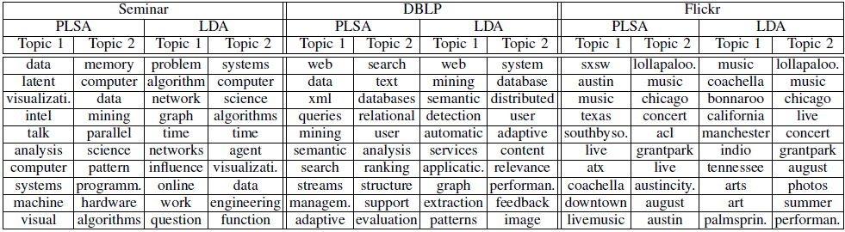
LPTA vs. Topic Models
Selected topics discovered for different datasets by using PLSA and LDA

Slide 46
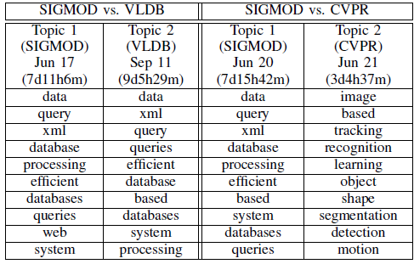
Integration of Text and Time
Periodic topics for SIGMOD vs. VLDB and SIGMOD vs. CVPR datasets by using LPTA. The date and the duration are the mean and standard deviation of the timestamps.
SIGMOD and VLDB are two reputed conferences in database area, and it is difficult to differentiate these two conferences based on text only
SIGMOD and CVPR are held in June, so it is difficult to differentiate these two if we rely on time information only

Slide 47
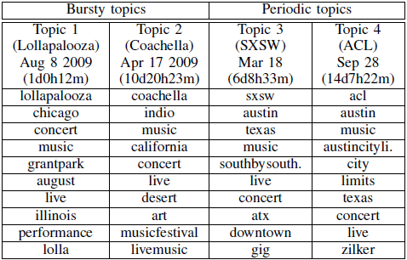
Periodic vs. Bursty Topics
Instead of pooling the photos related to music festivals all together, we keep the photos related to SXSW and ACL festivals from 2006 to 2010 and those related to Coachella and Lollapalooza in 2009 only
The words will fit into the corresponding periodic or bursty topics if they have periodic or bursty patterns

Slide 48
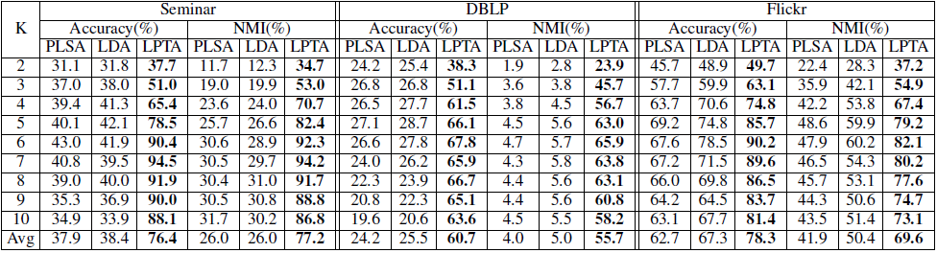
Quantitative Evaluation
The latent topics discovered by the topic modeling approaches can be regarded as clusters
Accuracy and normalized mutual information (NMI) can be used to measure the clustering performance
Conclusion: The LPTA model discovers the latent periodic topics by combining the information from topical clusters and periodic patterns

Slide 49
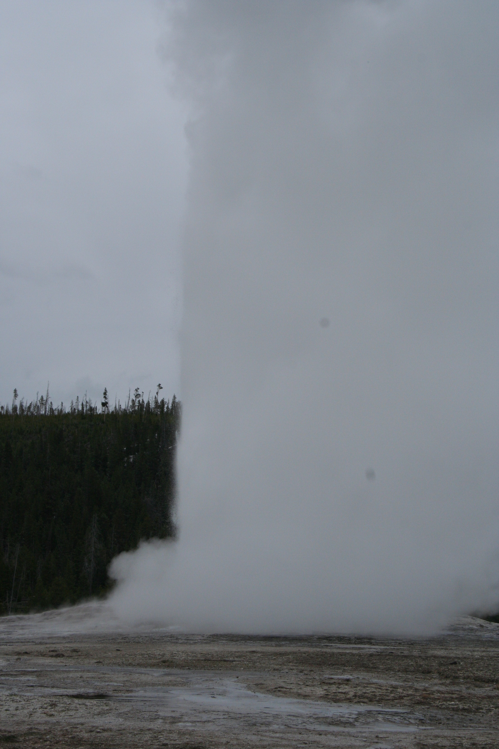

Slide 50
Outline
Introduction
Mining Geospatial Patterns
Mining and Aggregating Patterns over Multiple Trajectories
Mining Semantic-Rich Movement Patterns
Mining Periodic Movement Patterns
GeoTopic Discovery in Social Media Data
Latent Periodic Topic Discovery
Real-Time Local Event Detection from Geo-Tagged Social Media
Summary

Slide 51
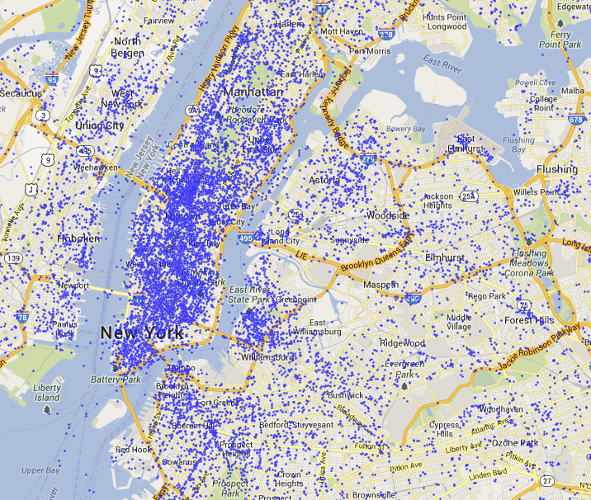



GeoBurst: Real-time Local Event Detection in Geo-Tagged Tweet Streams [SIGIR’16]
C. Zhang, G. Zhou, Q. Yuan, H. Zhuang, Y. Zheng, L. Kaplan, S. Wang, J. Han, “GeoBurst: Real-time Local Event Detection in Geo-Tagged Tweet Streams”, SIGIR’16
Local Event: A local events is an unusual activity bursted within a local area and specific duration while engaging a considerable number of participants
E.g., parade, riot, sport game, concert, accident, disaster
The geo-tagged tweet stream brings new opportunities to this problem because of its (1) sheer size; (2) multi-dimensional information; and (3) real-time nature

Slide 52
Research Challenges
Major challenges
Integrating multiple types of data: Location, time and text
Extracting interpretable events from tremendous noises (tweets are noisy and short)
On-line and real-time detection
Previous work
Most existing event detection methods are designed for detecting global events
Bursty in the entire stream; but local events are “bursty” in a small region and involve a relatively small number of tweets
Some local event detection methods
Not model the correlations between keywords; or are incapable of detecting local events in real time

Slide 53


Insight and Problem Definition
A local event usually leads to many related tweets around the location (a geo-topic cluster)
But a geo-topic cluster is not necessarily a local event
It may be a routine activity in that region (e.g., shopping)
It may be a global event rather than a local one (e.g., TV show)
Our task: Given the geo-tagged tweet stream, we aim to
detect all local events in any query time window (batch mode)
update the result list in real time as the query window shifts continuously (online mode)
We define a local event as a geo-topic cluster that shows clear spatiotemporal burstiness

Slide 54
Overview of GeoBurst
GeoBurst, a reference-based method for local event detection
It consists of three key components:
A candidate generator that finds geo-topic clusters in the query time frame, and regard them as candidate events
A ranking module that summarizes the routine activities in different regions to filter non-event candidates
An updater that updates local events in real time as the query window shifts

Slide 55


Candidate Event Generation (I) Find Geo-Topic Clusters
Find geo-topic clusters in the query time frame as candidate events
Geo-topic cluster (a group of tweets): geographically close & semantically relevant
Intuition: the spot where the event occurs is acting as a pivot that produces relevant tweets around it
Our clustering algorithm is based on:
a geo-topic authority score for each tweet
an authority ascent process to find authority maxima as pivots
Computing geo-topic authority
Geographical impact: calculated by a kernel function (d and d’ are tweets)
Semantic impact: calculated by random walk on a keyword co-occurrence graph

Slide 56


Candidate Event Generation (II) Pivot & Authority Ascent
Geo-topic authority: A tweet gets an authority score from neighbor tweets where
The geographical impact is captured by kernel function
The semantic impact is captured by random walk on the keyword co-occurrence graph
A pivot is an authority maximum: a prominent tweet that is surrounded by many relevant tweets
A pivot attracts similar tweets to form geo-topic clusters
Find all the pivots in the geo-topic space by Authority Ascent
geo-impact
authority
semantic impact
Authority can be interpreted as the total amount of energy received from the neighbors

Slide 57



The Ranking Module
We design the activity timeline structure to summarize the activities in different spatial regions and time periods
The summaries in the activity timeline serve as background knowledge to quantify the spatiotemporal burstiness of candidates
Each snapshot is a set of micro-clusters
Each cluster is an activity summary for a region
Retrieve the snapshots in a reference window as background knowledge
Compute z-score for each candidate as its ranking score

Slide 58
The Update Module
In the entire process of GeoBurst, the most time-consuming step is pivot finding
How to avoid finding pivots from scratch as the query window shifts?
The key is to maintain the local pivot for each tweet
We design an updating strategy based on the additive property of authority score:
subtracting the contributions of outdated tweets
emphasizing the contributions of new tweets

Slide 59

Experiments (Algorithm Comparison)
Data:
NYC: 9M geo-tagged tweets in New York during 3 months
LA: 8M geo-tagged tweets in Los Angeles during 3 months
Task: 80 queries with different durations (3h, 4h, 5h, 6h), find top-5 local events in each query window
Compared Method: EvenTweet (PVLDB’13), Wavelet (CIKM’09)
Evaluation: The crowdsourcing platform CrowdFlower
Ask the workers to judge whether the result is a local event
Precision Comparison

Slide 60

Experiments (Illustrative Cases)

Slide 61


Slide 62
Outline
Introduction
Mining Geospatial Patterns
Mining and Aggregating Patterns over Multiple Trajectories
Mining Semantic-Rich Movement Patterns
Mining Periodic Movement Patterns
GeoTopic Discovery in Social Media Data
Latent Periodic Topic Discovery
Real-Time Local Event Detection from Geo-Tagged Social Media
Summary

Slide 63
Summary
Emerging: Integrated mining spatiotemporal and social media data
Mining Geospatial Patterns
Mining and Aggregating Patterns over Multiple Trajectories
Mining Semantic-Rich Movement Patterns
Mining Periodic Movement Patterns
GeoTopic Discovery in Social Media Data
Latent Periodic Topic Discovery
Real-Time Local Event Detection from Geo-Tagged Social Media
Integrated data mining with spatiotemporal, social and trajectory data
Integrated mining with four dimensions: Spatial + Temporal + Text + Network

Slide 64
References (I)
F. Giannotti, M. Nanni, F. Pinelli, D. Pedreschi, Trajectory Pattern Mining, KDD’07
Y. Huang, S. Shekhar, H. Xiong, Discovering colocation patterns from spatial data sets: A general approach, IEEE Trans. on Knowledge & Data Eng., 16(12), 2004
K. Koperski, J. Han, “Discovery of Spatial Association Rules in Geographic Information Databases”, SSD’95
J.-G. Lee, J. Han, and K.-Y. Whang, "Trajectory Clustering: A Partition-and-Group Framework", SIGMOD'07
Z. Li, B. Ding, J. Han, R. Kays, “Swarm: Mining Relaxed Temporal Moving Object Clusters”, VLDB’10
Z. Li, B. Ding, J. Han, R. Kays, P. Nye, “Mining Periodic Behaviors for Moving Objects”, KDD’10
Z. Li, J. Wang and J. Han, "ePeriodicity: Mining Event Periodicity from Incomplete Observations", IEEE TKDE, 27(5): 1219-1232, 2015
Z. Yin, L. Cao, J. Han, C. Zhai, and T. Huang, “Geographical Topic Discovery and Comparison”, WWW'11
Z. Yin, L. Cao, J. Han, J. Luo, and T. S. Huang, "Diversified Trajectory Pattern Ranking in Geo-tagged Social Media", SDM'11
C. Zhang, J. Han, L. Shou, J. Lu, and T. La Porta, "Splitter: Mining Fine Grained Sequential Patterns in Semantic Trajectories", VLDB'14
C. Zhang, G. Zhou, Q. Yuan, H. Zhuang, Y. Zheng, L. Kaplan, S. Wang, J. Han, “GeoBurst: Real-time Local Event Detection in Geo-Tagged Tweet Streams”, SIGIR’16

Slide 65

Diversified Trajectory Pattern Ranking
Given a collection of geo-tagged photos along with users, locations and timestamps, how to rank the mined trajectory patterns with diversification into consideration?
Input: A collection of geo-tagged photos (user, date time, GPS location)
Our Framework
Extract trajectory patterns from the photo collection
Rank the trajectory patterns by estimating their importance according to user, location and trajectory pattern relations
Diversify the ranking result to identify the representative trajectory patterns from all the candidates
(1) Extract trajectory patterns
(2) Rank trajectory patterns
(3) Diversify ranked patterns
Output: Diversified trajectory pattern ranking result
Ex.: Top ranked trajectories in London, New York and Paris

Slide 66




Data Preprocessing and Pattern Discovery
Cluster locations: mean-shift algorithm (27974 photos in London)
Form sequences
PrefixSpan [Pei et al. TKDE 2004]
Ex. (min-support = 2)
Three frequent sequential patterns:
londoneye → bigben
londoneye → bigben → trafalgarsquare
londoneye → tatemodern
londoneye, trafalgarsquare, britishmuseum, bigben, towerbridge, piccaillycircus, buckinghampalace, tatemodern, …
ID | User | Date | Sequence
1 | Alice | 04/26/11 | londoneye -> bigben -> downingstreet -> trafalgarsquare
2 | Alice | 04/27/11 | londoneye -> tatemodern -> towerbridge
3 | Bob | 04/26/11 | londoneye -> bigben -> tatemodern
… | … | … | …

Slide 67








Rank Trajectory Patterns
The top frequent trajectory patterns are short but not informative, e.g.,
How to rank trajectory patterns?
A trajectory pattern is important if many important users take it and it contains important locations
A user is important if the user takes photos at important locations and visits the important trajectory patterns
An location is important if it occurs in one or more important trajectory patterns and many important users take photos at the location

Slide 68


Trajectory Pattern Ranking Algorithm
P_{T} is the eigen-vector for M^{T}M for the largest eigen value, M = M_{TU} M_{UL}M_{LT}
The algorithm is a normalized power iteration method to detect the eigen-vector of M^{T}M for the largest eigen-value if the intial P_{T} is not orthogonal to it
Based on the algorithm, we can derive the top-trajectory in London
londoneye → bigben → downingstreet → horseguards → trafalgarsquare

Slide 69


Top-Ranked Trajectories Are often Highly Biased to only a few Locations
Top-Ranked Locations in London
P_{L} : the importance score for location L
# user: #users visited the location
Top-Ranked Trajectories in London
highly biased to only a few locations
Trajectory 1 (londoneye → bigben → downingstreet → horseguards → trafalgarsquare)
Trajectory 5 (westminster → bigben → downingstreet → horseguards → trafalgarsquare)

Slide 70


From Top-Ranked to Diversified Ranked Trajectories
Diversified Ranked Trajectories in London
Trajectories 2, 4, & 5 are popular routes to explore street arts in London
Location Recommendation in London
Rank the locations by the scores of trajectories (append current trajectory with next destination)

